Slide 2
-
UMF:
Nov 2023
Contribution of international students
We must continue to make the case, with media and politicians, for international students and their contribution to the UK.
To date, we have delivered:
•Public polling showing majority of public (64%) felt UK should host the same or more international students (with only 9% against).
•Economic impact report evidencing that one cohort of international students provides £41.9 billion to the UK economy.
•Relaunched the #WeAreInternational campaign (soft relaunch took place in May 2023).

Slide 3
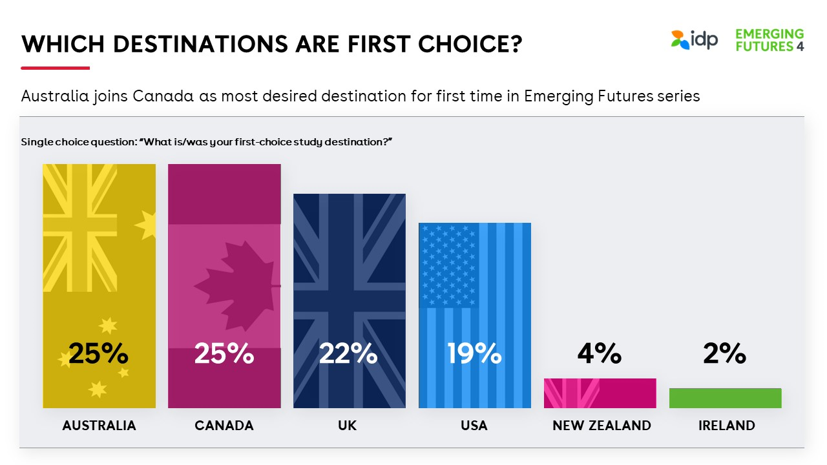
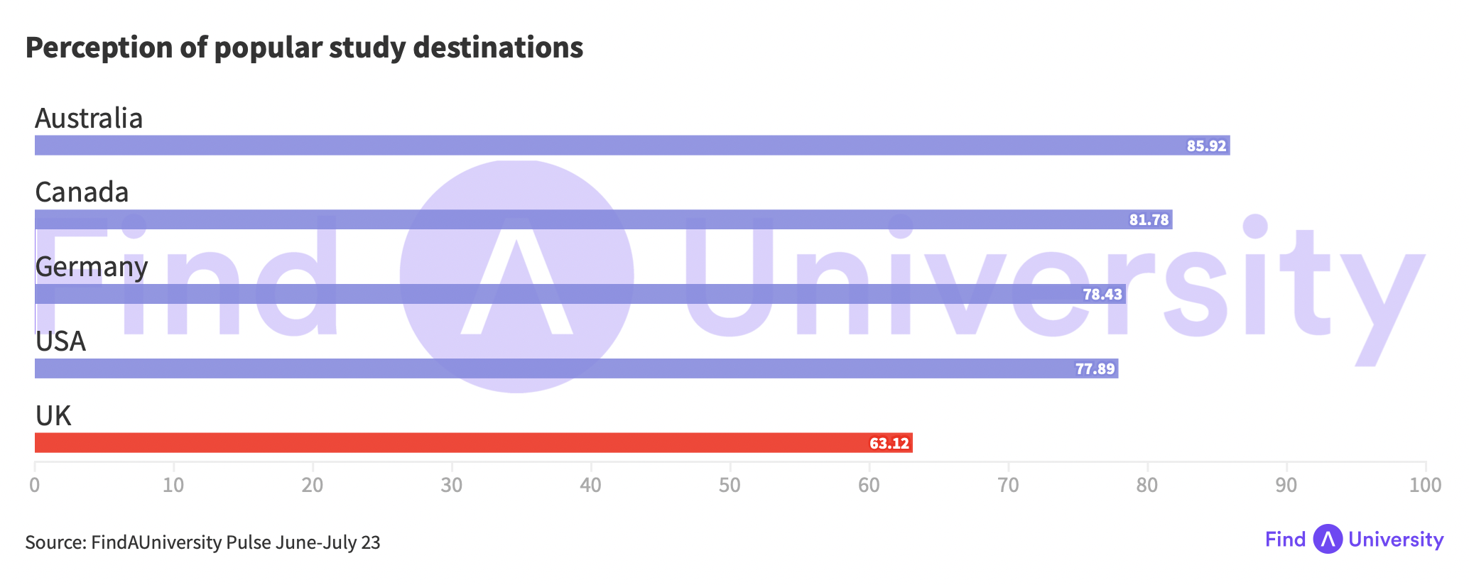
-
UMF:
Nov 2023
An unwelcoming study destination
Anti-immigration rhetoric, uncertainty and policy change play to an ‘unwelcoming’ narrative.
We need to change perceptions with prospective international students around how welcoming they perceive the UK to be as a study destination.
We are perceived to be the least welcoming of the top 5 study destinations, having been top during Covid.

Slide 4
-
UMF:
Nov 2023
Our challenge
The best way to maintain and enhance reputation, is to tell a story true to your mission and purpose…
• To bring people from different backgrounds, race and religion; values, beliefs and nationalities; together in environments where they are empowered to share views freely in open, respectful debate…
• That’s how we grow knowledge, broaden understanding in the world, and transform lives.
• How do we tell a story - one that inspires and wins hearts – that is true to this?

Slide 5
-
UMF:
Nov 2023
My inspiration!

Slide 6
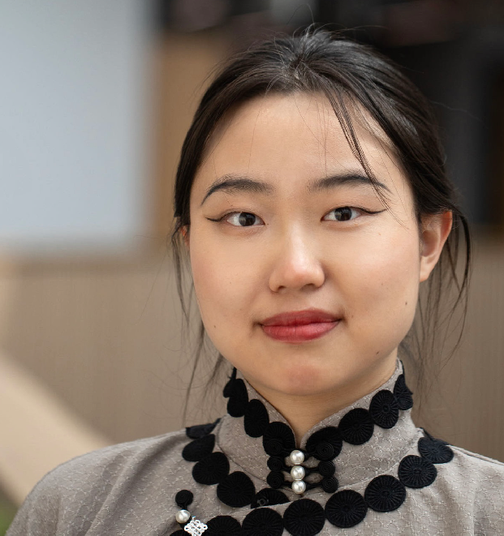
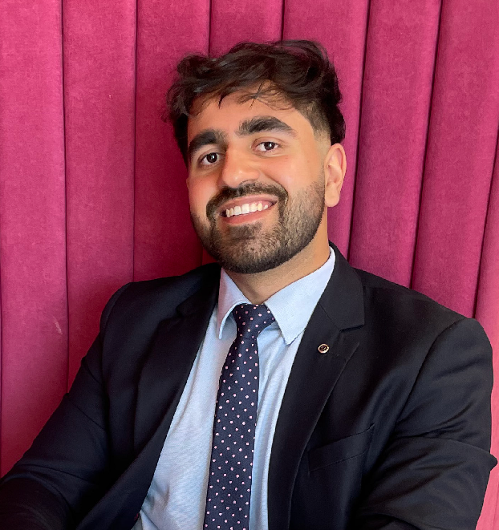
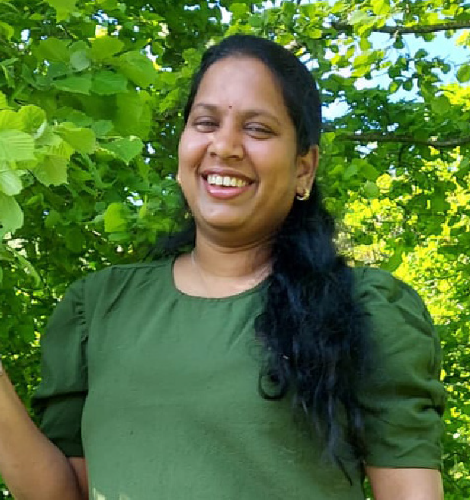
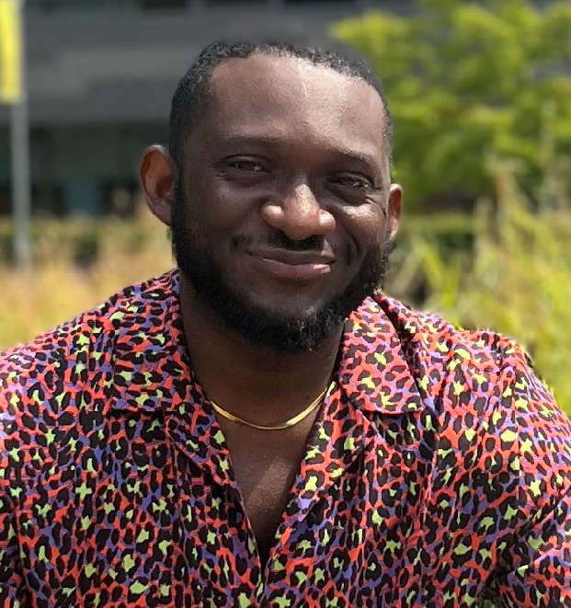
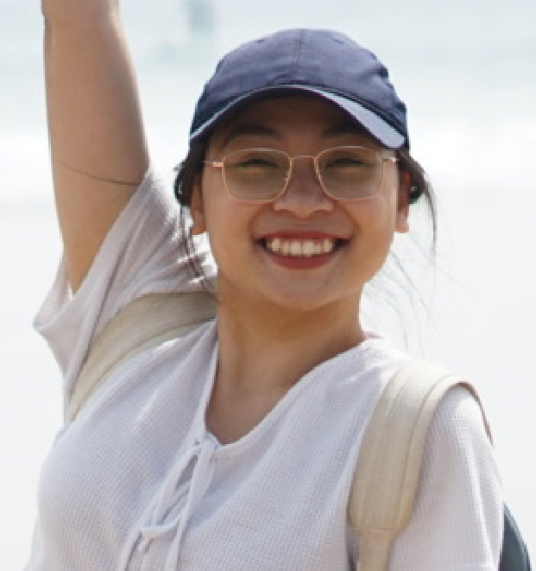
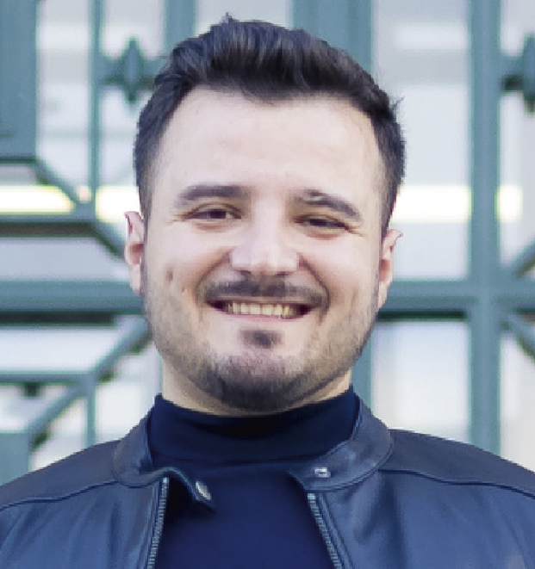
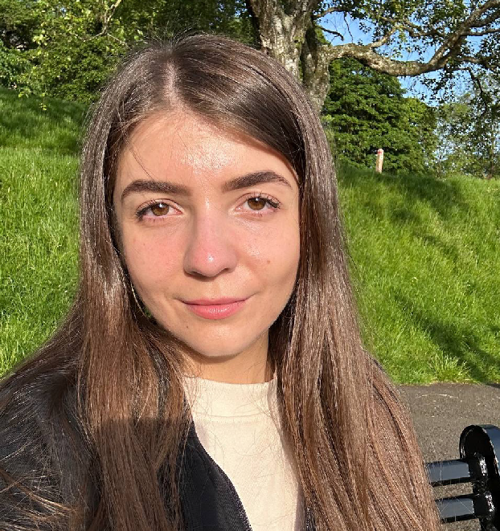
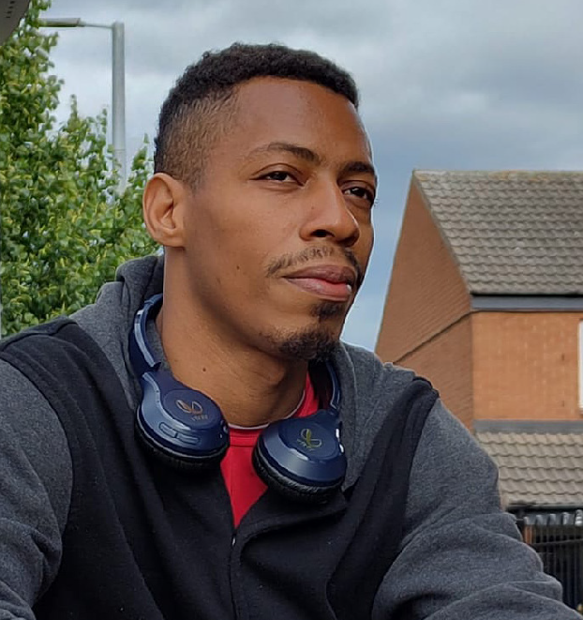
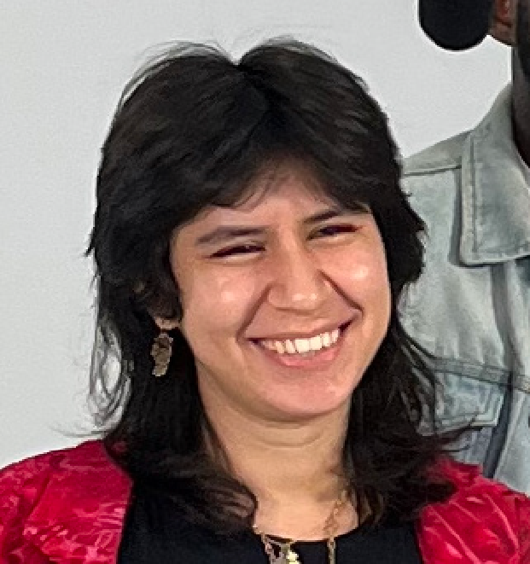
-
UMF:
Nov 2023
Introducing our storytellers
Notes:
Let’s give you a sneak peak and introduce you to the stars of the campaign:
Yi - China - University of Sheffield
Zee – Pakistan - London South Bank
Siri – India - Wrexham
Charles – Nigeria - Anglia Ruskin
Minh – Vietnam - Swansea
Dhionis – Albania - University of Leeds
Khrystyna – Ukraine - University of Glasgow
Tremaine – Belize - Nottingham Trent
Shayla – Finland - University of Leicester
Isabel – Spain - Imperial College

Slide 7
-
UMF:
Nov 2023
Campaign timeline / get involved
W/c 25th Sept | W/c 2nd Oct | W/c 16th Oct | W/c 30th Oct | W/c 13th Nov
Campaign launch / launch webinar | Student stories 1-3 launch | Student stories 4-6 launch | Student stories 7-10 launch | International students’ day moment (17th)
Welcome Week push |  | UUKi Conference: campaign session
Toolkit circulation, and pulse/polls/impact surveys
Content partner amplification, paid social media campaign and PR activity

Slide 8
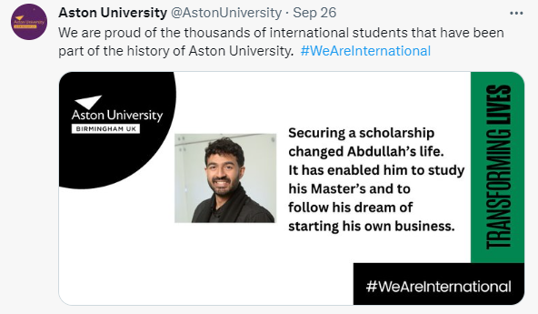
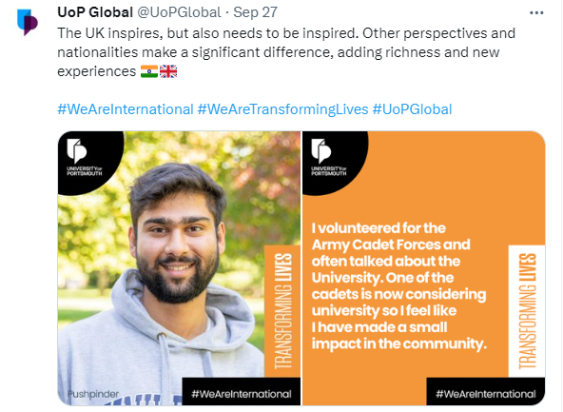
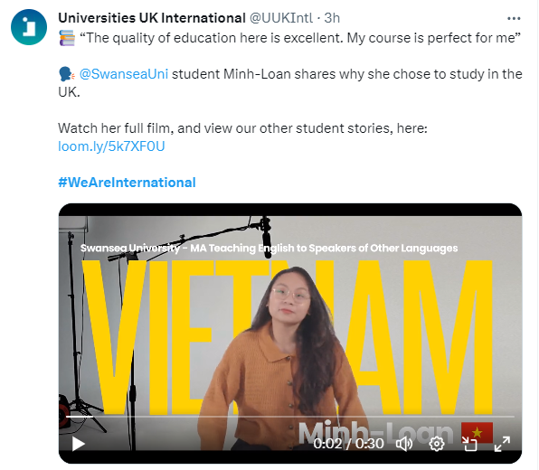
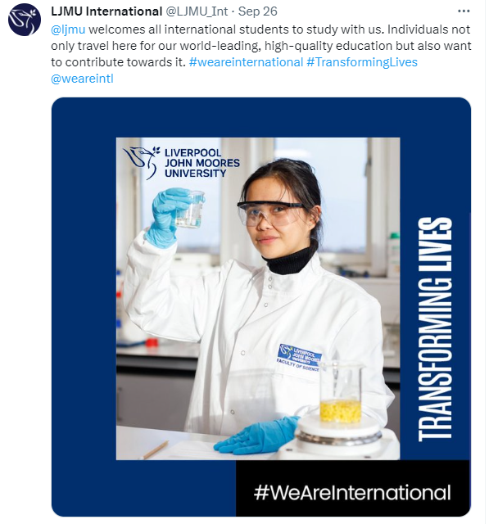
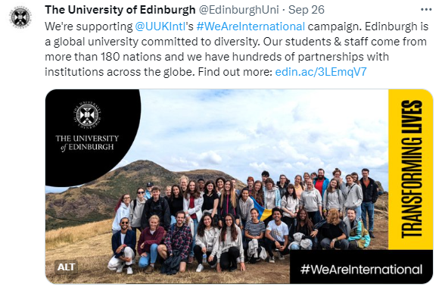
-
UMF:
Nov 2023
Impact to date
More than 80 universities have joined the campaign
30m+ reach across social media
250,000+ consistently watching more than 50% of the campaign video content
12% uplift in positive UK media sentiment around international students since start of the campaign
38% uplift in perceptions of welcome to date.

Slide 9
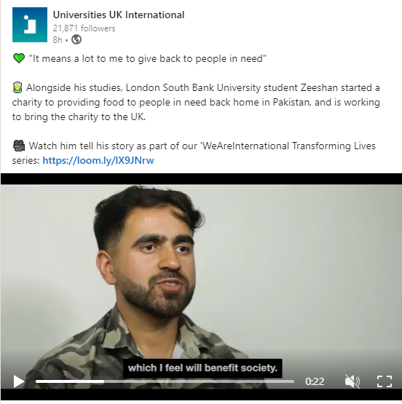
-
UMF:
Nov 2023
What’s next...
Phase two ideas:
Wider range of international student voices (TNE, pathway, online, etc.)
More international graduate voices
Spring 2024 launch
Co-funding model: looking for universities interested in working with us and Waterfall to produce lead/hero content.

Slide 10
-
UMF:
Nov 2023
Thank you
Andy Howells
Assistant Director, External Affairs, Universities UK International​ (until 24 November)
Andrew.Howells@international.ac.uk
From 27 November: Chief Marketing Officer, NCUK
Andrew.Howells@NCUK.ac.uk
Sophie O’Neill
Head of Communications and Campaigns, Universities UK International
Sophie.O’Neill@international.ac.uk
​

